Slide 1
2D line-shape analysis of the fifth order signals
František Šanda,
Charles University, Prague
Constantin Heshmatpour
Experiments at TU Munich:
Jürgen Hauer, Pavel Malevich

Slide 2
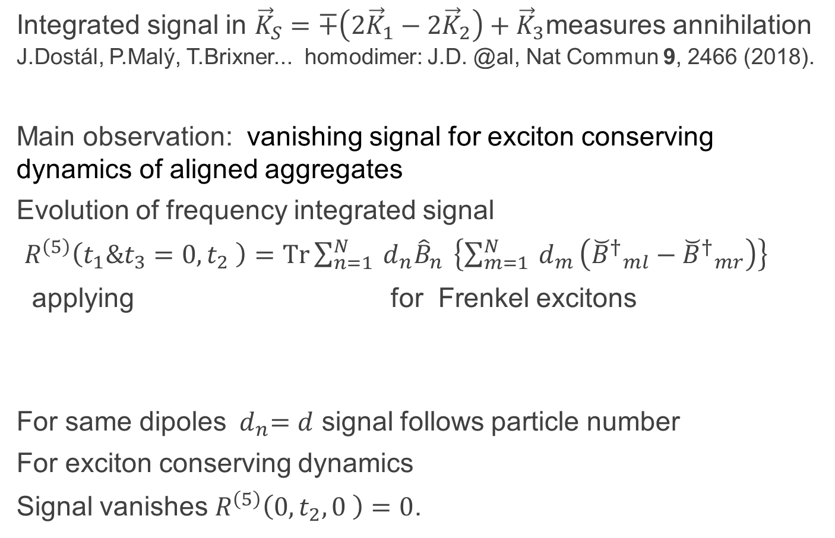
Signals of exciton Annihilation
Integrated signal in ${\vec{K}}_{S}=∓\left({2\vec{K}}_{1}−{2\vec{K}}_{2}\right)+{\vec{K}}_{3}$measures annihilation J.Dostál, P.Malý, T.Brixner... homodimer: J.D. @al, Nat Commun 9, 2466 (2018).
Main observation: vanishing signal for exciton conserving dynamics of aligned aggregates
Evolution of frequency integrated signal
$R^{\left(5\right)}\left(t_{1}\&t_{3}=0, t_{2} \right)=Tr\sum_{n=1}^{N}{{ d}_{n}{\hat{B}}_{n} }\left\{\sum_{m=1}^{N}{{ d}_{m}}\left({{\breve{B}}^{†}}_{ml}−{{\breve{B}}^{†}}_{mr}\right)\right\}$
applying for Frenkel excitons
For same dipoles ${ d}_{n}=d$ signal follows particle number
For exciton conserving dynamics
Signal vanishes $R^{\left(5\right)}\left(0, t_{2},0 \right)=0$.

Slide 3
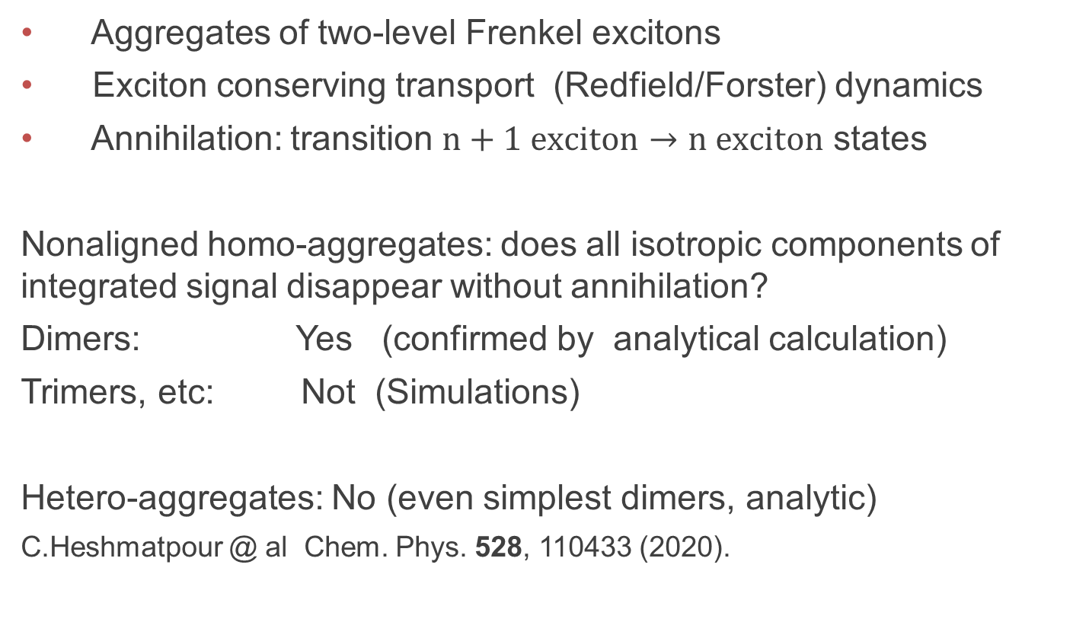
Non-aligned & hetero aggregates: simulations made using many-body master equation for:
Aggregates of two-level Frenkel excitons
Exciton conserving transport (Redfield/Forster) dynamics
Annihilation: transition $n+1 exciton→n exciton$ states
Nonaligned homo-aggregates: does all isotropic components of integrated signal disappear without annihilation?
Dimers: Yes (confirmed by analytical calculation)
Trimers, etc: Not (Simulations)
Hetero-aggregates: No (even simplest dimers, analytic)
C.Heshmatpour @ al Chem. Phys. 528, 110433 (2020).

Slide 4
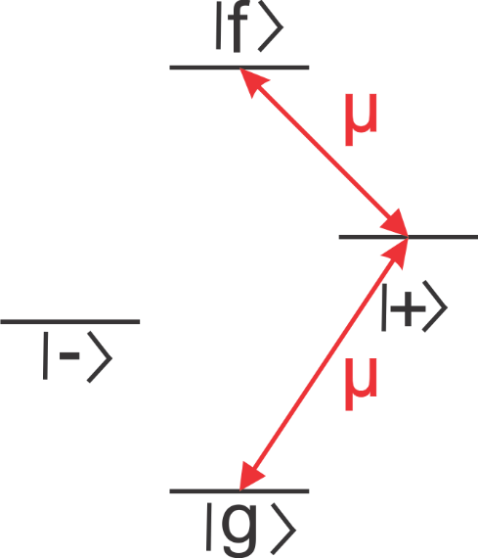
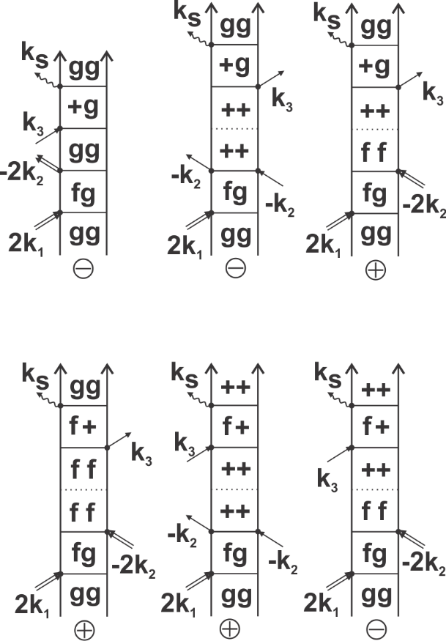
Alternative to integrated signal
Analyzing the volume evolution of separated peaks
Example: Strongly coupled dimer
Integrated signal arises with P1 disappearance

Slide 5

Dynamics through peaks
Example: strongly coupled trimer
This peak structure is typical for larger aggregates
Works well for non-aligned structures
2Q ESA peak specific for annihilation dynamics

Slide 6
Line-shaping
30 fs annihilation measured in squaraine trimer (bent structure)
C.Heshmatpour @ al J. Phys. Chem. Lett.11, 7776 (2020)
Unresolved: peak shape (tilt)
Q1: can tilt‘s dynamics be attributed to spectral diffusion similarly as in 2DES (2DIR)?

Slide 7
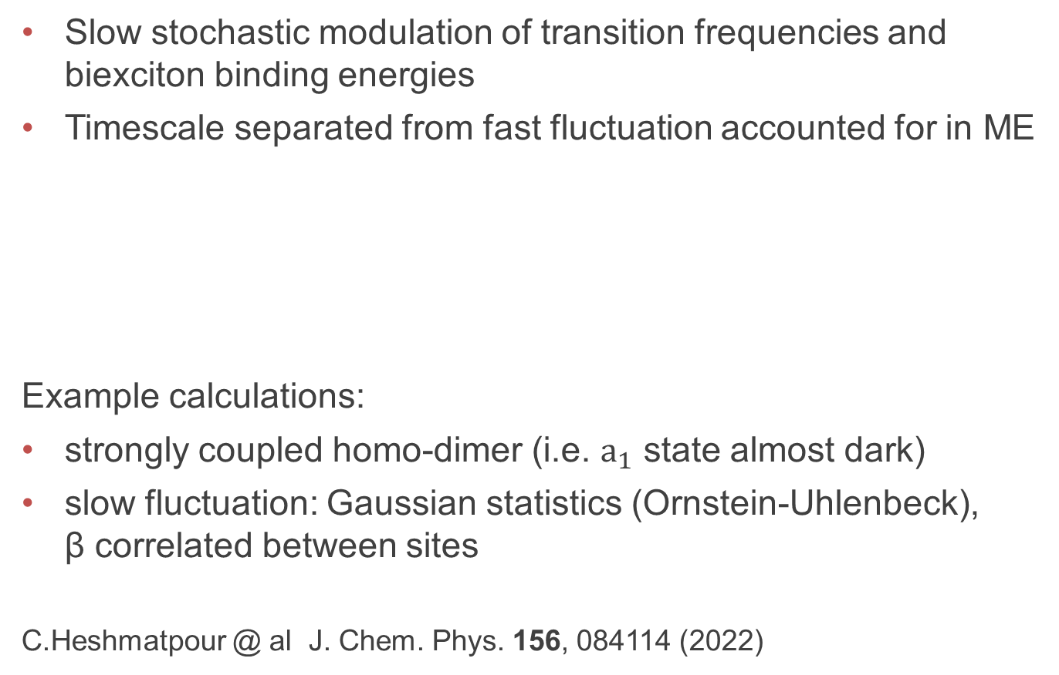
Spectral Diffusion model
Slow stochastic modulation of transition frequencies and biexciton binding energies
Timescale separated from fast fluctuation accounted for in ME
Example calculations:
strongly coupled homo-dimer (i.e. $a_{1}$ state almost dark)
slow fluctuation: Gaussian statistics (Ornstein-Uhlenbeck), β correlated between sites
C.Heshmatpour @ al J. Chem. Phys. 156, 084114 (2022)

Slide 8
Q2: what type of correlation is expressed?
.

Slide 9
Spectral diffusion of transition frequencies on aligned homo-dimer
(biexciton binding Δ stable)
Lineshapes (left) correspond to statistics of transition (right)

Slide 10
Q3: what measure is convevient to characterize tilt?
Tilt dynamics related to correlation function
Main axis tilt
Center line slope

Slide 11
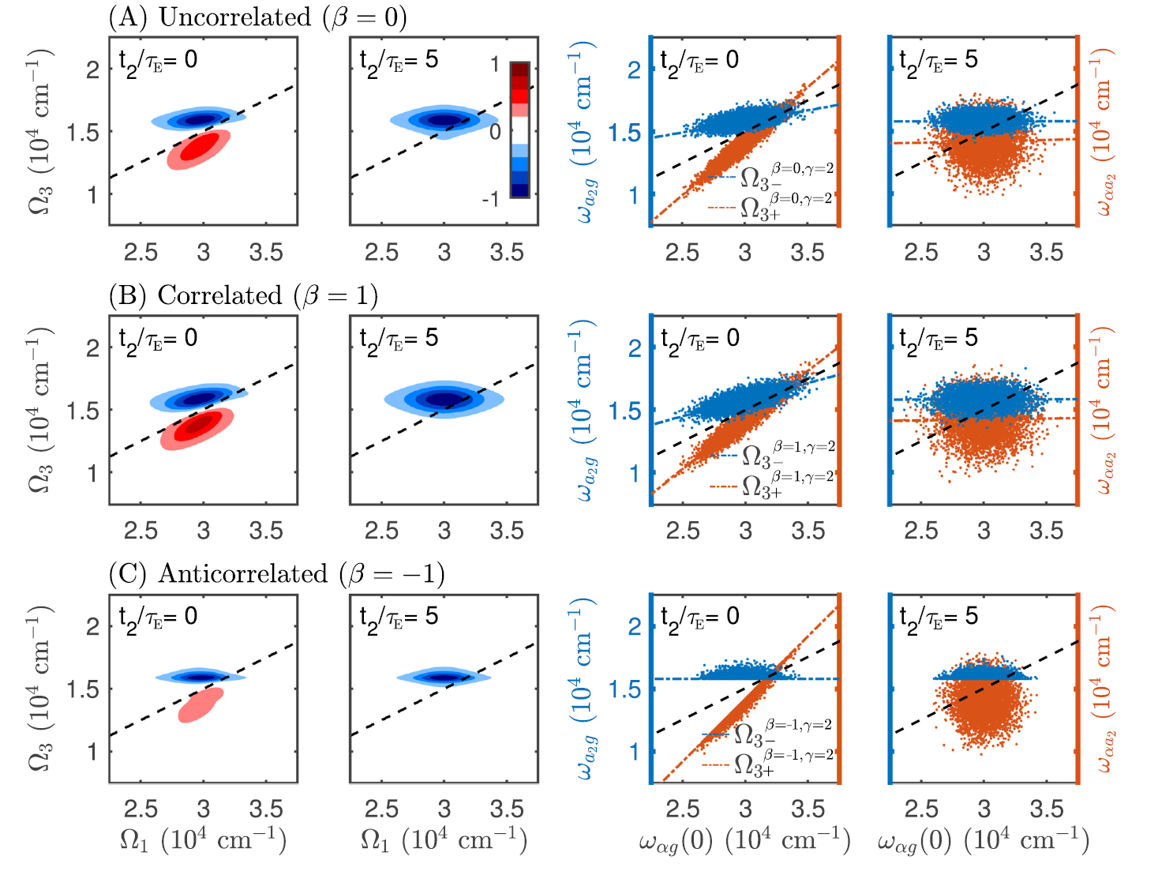
larger sensitivity to
Δ (biexciton binding) modulations

Slide 12
Summary
Integrated R5 signal formally proved to report annihilation in aligned homo-aggregates
Separation to peaks allows to measure annihilation in the non-aligned aggregates
Peak tilt reports on certain components of spectral diffusion
Acknowledgement: Czech Science Foundation

Slide 13
Thank you for your attention

